Slide 1
STORE SALES AAND PROFIT ANALYSIS
Name: Nisarga J R Department: MCA (BCU) Semester:Third
USN: P18BR23S126007

Slide 2
Outline
Title Name
Outline
Abstract
Problem Statement
Proposed Solution
Short Video
Implementation
Output Screenshots
References

Slide 3
Abstract:
The objective of store sales and profit analysis is to evaluate and understand the performance of a store or a group of stores in terms of revenue generation, profitability, and operational efficiency. This analysis provides actionable insights for making informed business decisions, optimizing resources, and maximizing profitability. Below are the primary objectives:

Slide 4
Problem Statement:
Store sales in a competitive retail environment, stores face challenges in understanding the factors that drive sales and profitability. Despite having access to large volumes of data, businesses often struggle to extract meaningful insights due to unorganized data, lack of efficient analysis techniques, and the inability to connect sales trends with profit outcomes. This can lead to inefficient resource allocation, poor inventory management, missed opportunities for growth, and suboptimal decision-making.
The problem lies in identifying key trends in sales performance, understanding profitability across products and stores, and uncovering actionable insights optimize operations and maximize profits. Without proper analysis, businesses risk overstocking low-demand products, understocking high-demand items, mismanaging operational costs, and failing to adapt to changing customer preferences.

Slide 5
Proposed Solution
the challenges identified in the problem statement, the solution involves implementing a systematic and data-driven approach to analyse store sales and profitability.
Below are the key components of the solution:
1. Data Collection and Integration
Centralized Data Repository: Collect and consolidate data from various sources such as sales systems, inventory databases, customer relationship management (CRM) systems, and marketing platforms.
Automated Data Pipeline: Set up an automated pipeline to ensure realtime or periodic data updates for accurate analysis.
Data Cleaning and Preparation: Address missing, duplicate, or inconsistent data to ensure the accuracy and reliability of insights.
2. Sales Performance Analysis
Trend Identification: Analyse historical sales data to identify patterns and seasonal trends.
Product Performance: Identify top-performing and underperforming products or categories.
Store Comparison: Compare sales across different store locations to understand regional performance differences.

Slide 6
Short Video
https://drive.google.com/file/d/12-PqXiuv2Q7tG4jPCGJsFnTX9m_FfzDv/view?usp=drivesdk

Slide 7
Implementation
https://github.com/NisargaJR

Slide 8
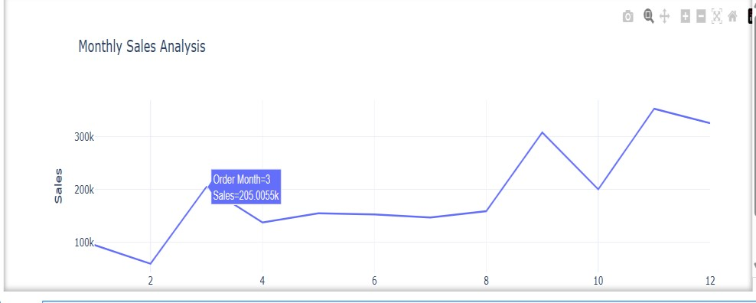
Output

